Slide 1

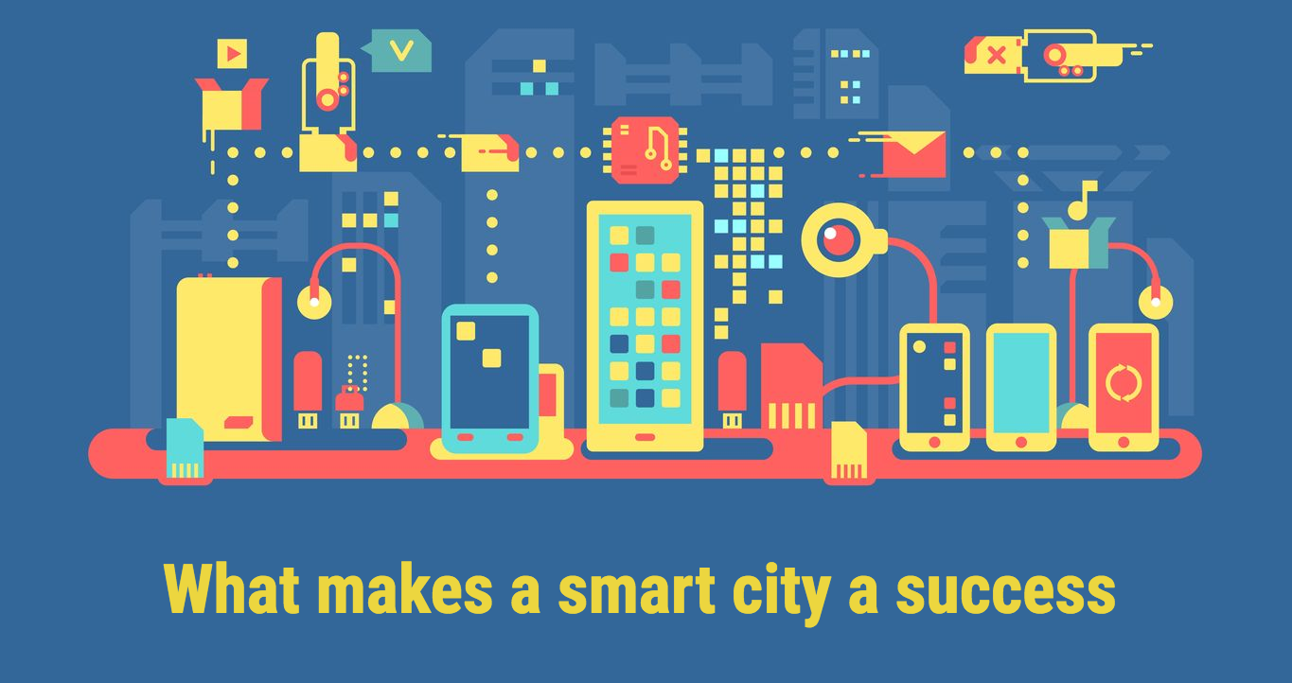
Potential Customer Analysis in China Mobile 5G Plan

Slide 2

Transformation trends of Smart city
5G networks are powerful support for
the construction of Smart city
Existing 5G subscribers are not enough
↓
Develop strategies to increase 5G subscribers

Slide 3
Dataset with 5G Label
EDA
Logistic Regression
Dataset A (No Label)
Data Processing
Decision Tree
Dataset B (No Label)
Random Forest
Evaluation
Parameter Tuning
Final Model
Classification
Add Label
Dataset A (with 5G Label)
Recommendation
on
5G Subscription Plan
Business Analysis
Dataset B (with 5G Label)
Strategy Design

Slide 4
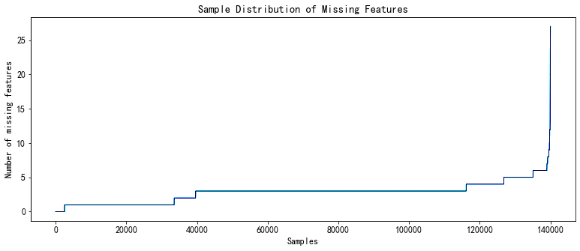
Sample Distribution of Missing Features

Slide 5
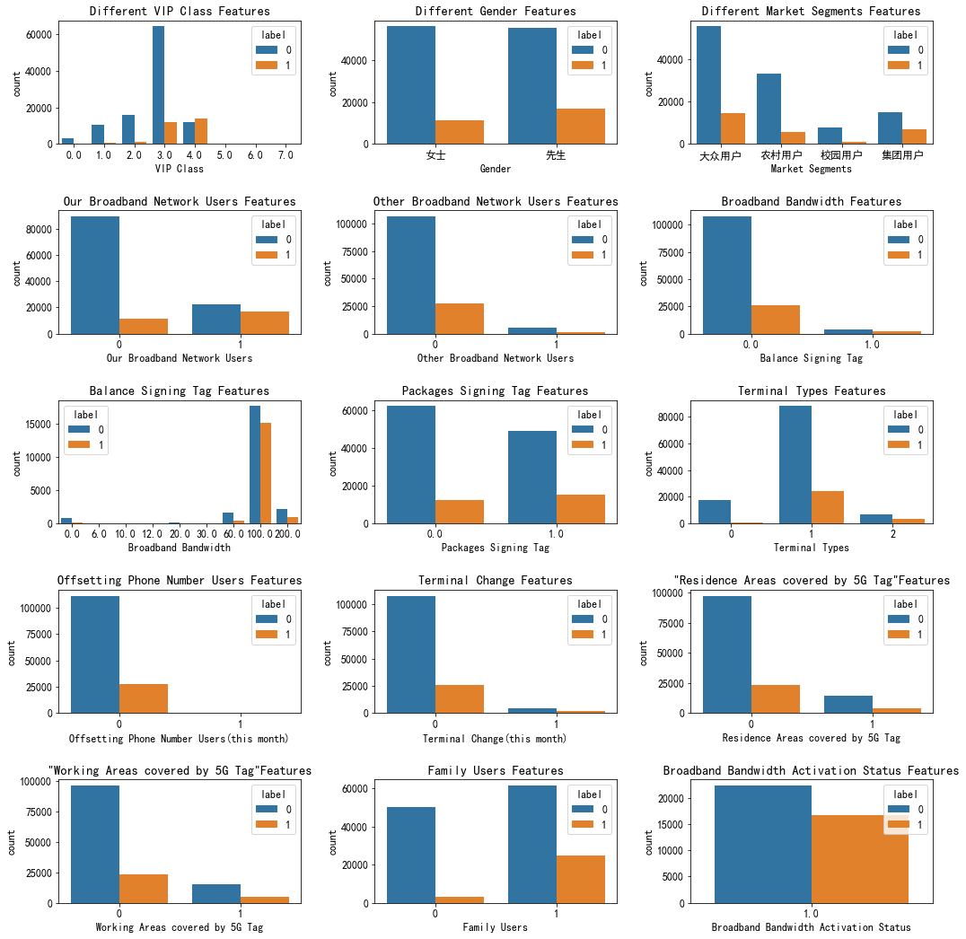
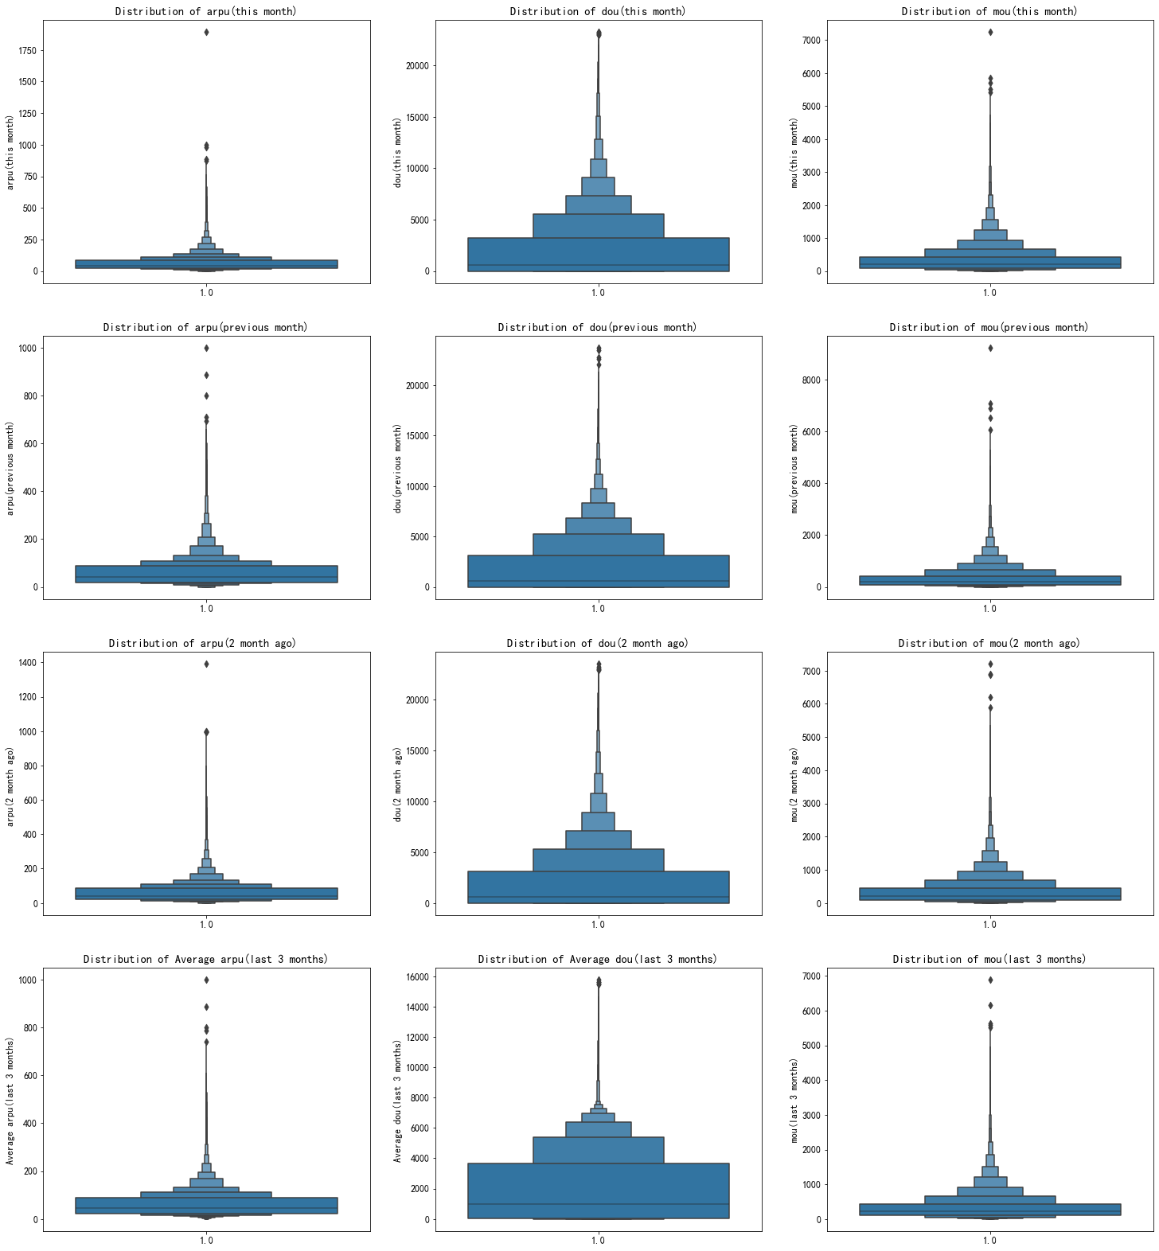
Category-Feature Independent Analysis
Numerical-feature independent analysis

Slide 6
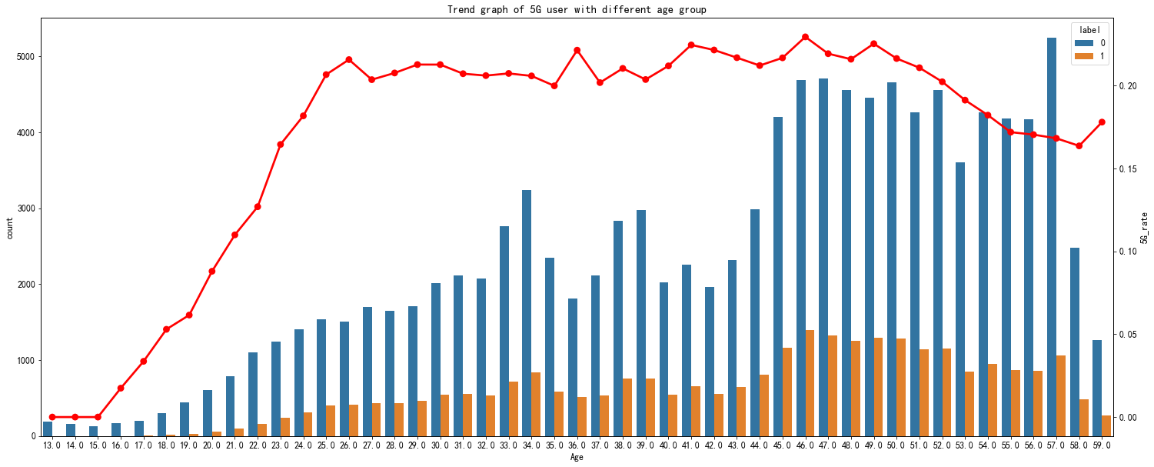
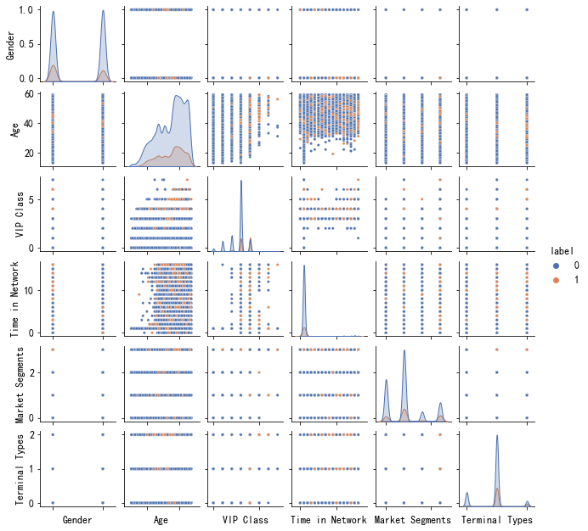
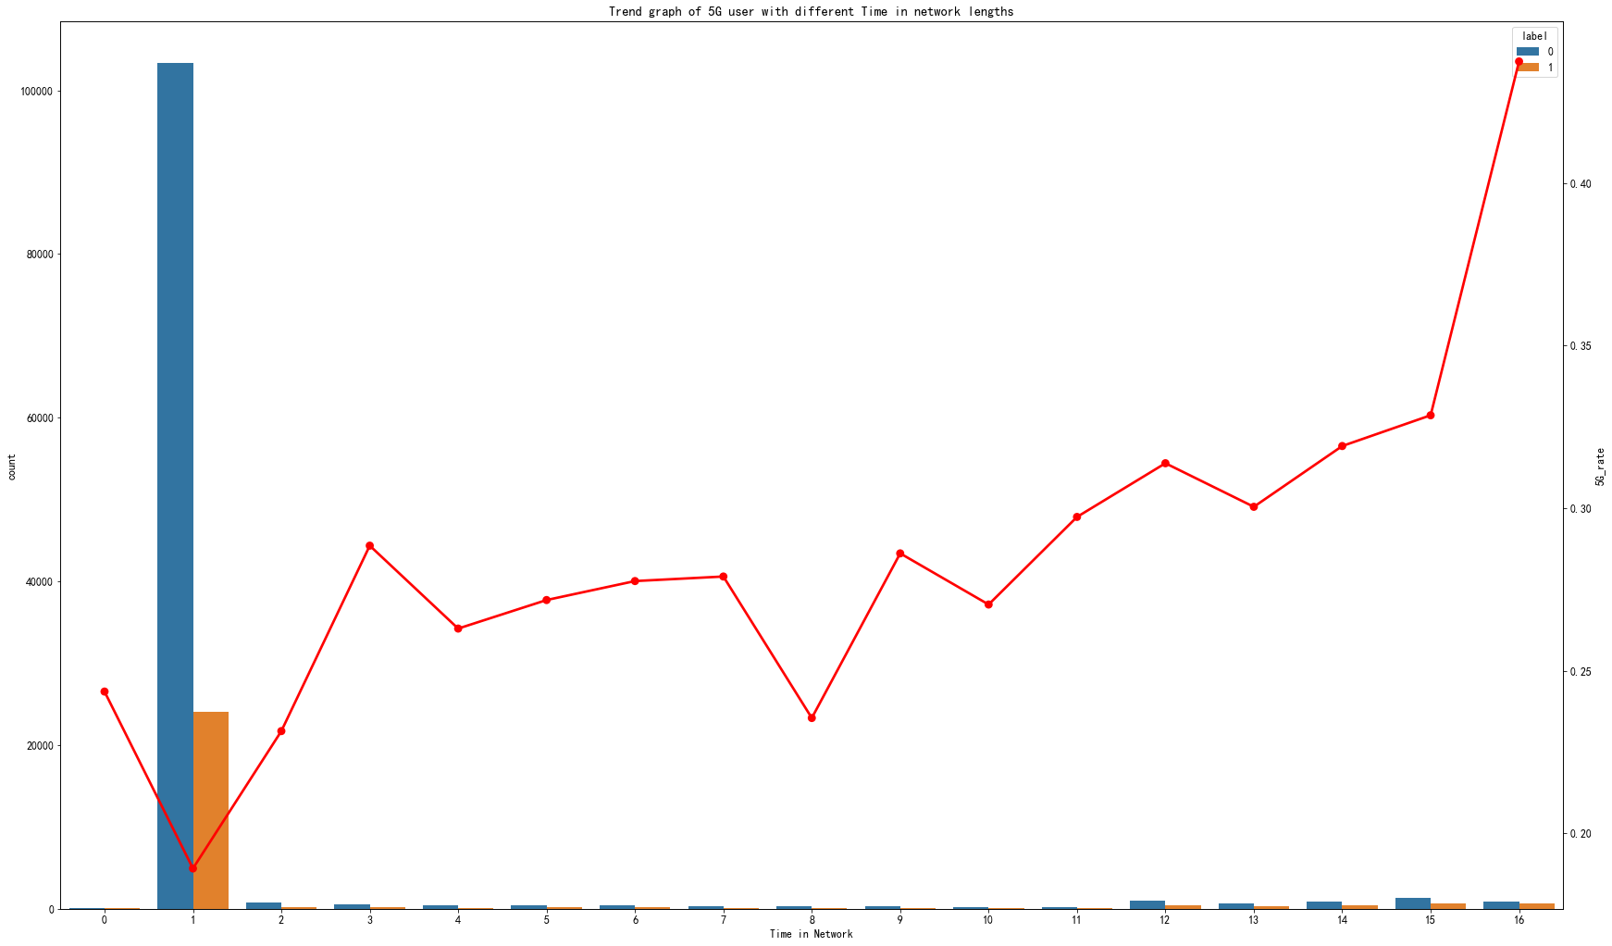
Trend graph of 5G user
with different Age
→
Trend graph of 5G user with
different Time in network
←

Slide 7
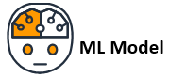
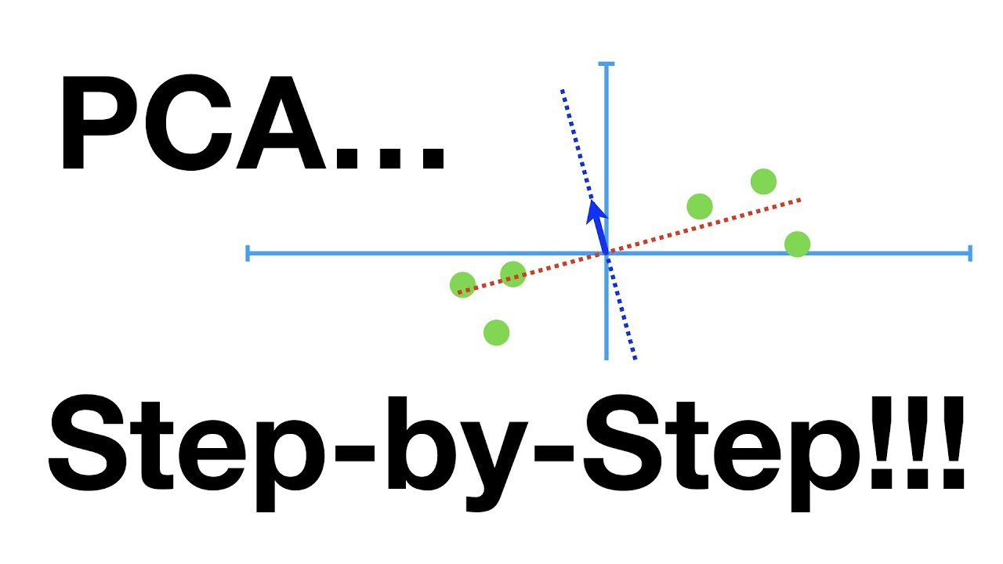
Numerical
Variable
same-value filtering method
True-Numerical
Variable
Pandas
Dataset
Categorical Variable 1
Categorical Variable 2
Handling
outliers
Categorical Variable
Numerical
Variable
Variable only
1 & NaN
Mode Filling
Median Filling
0-NaN
Filling
Dataset
(No missing value)
Label Encoder
Feature Combination
Final Dataset
Dataset
(Encoding completed)
Dimension Reduction

Slide 8
Main categorical feature correlation check

Slide 9
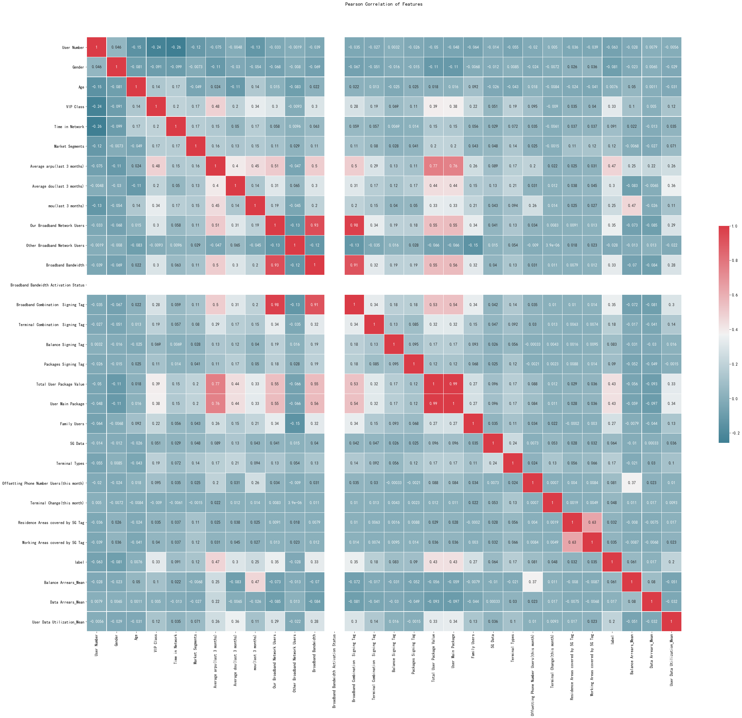
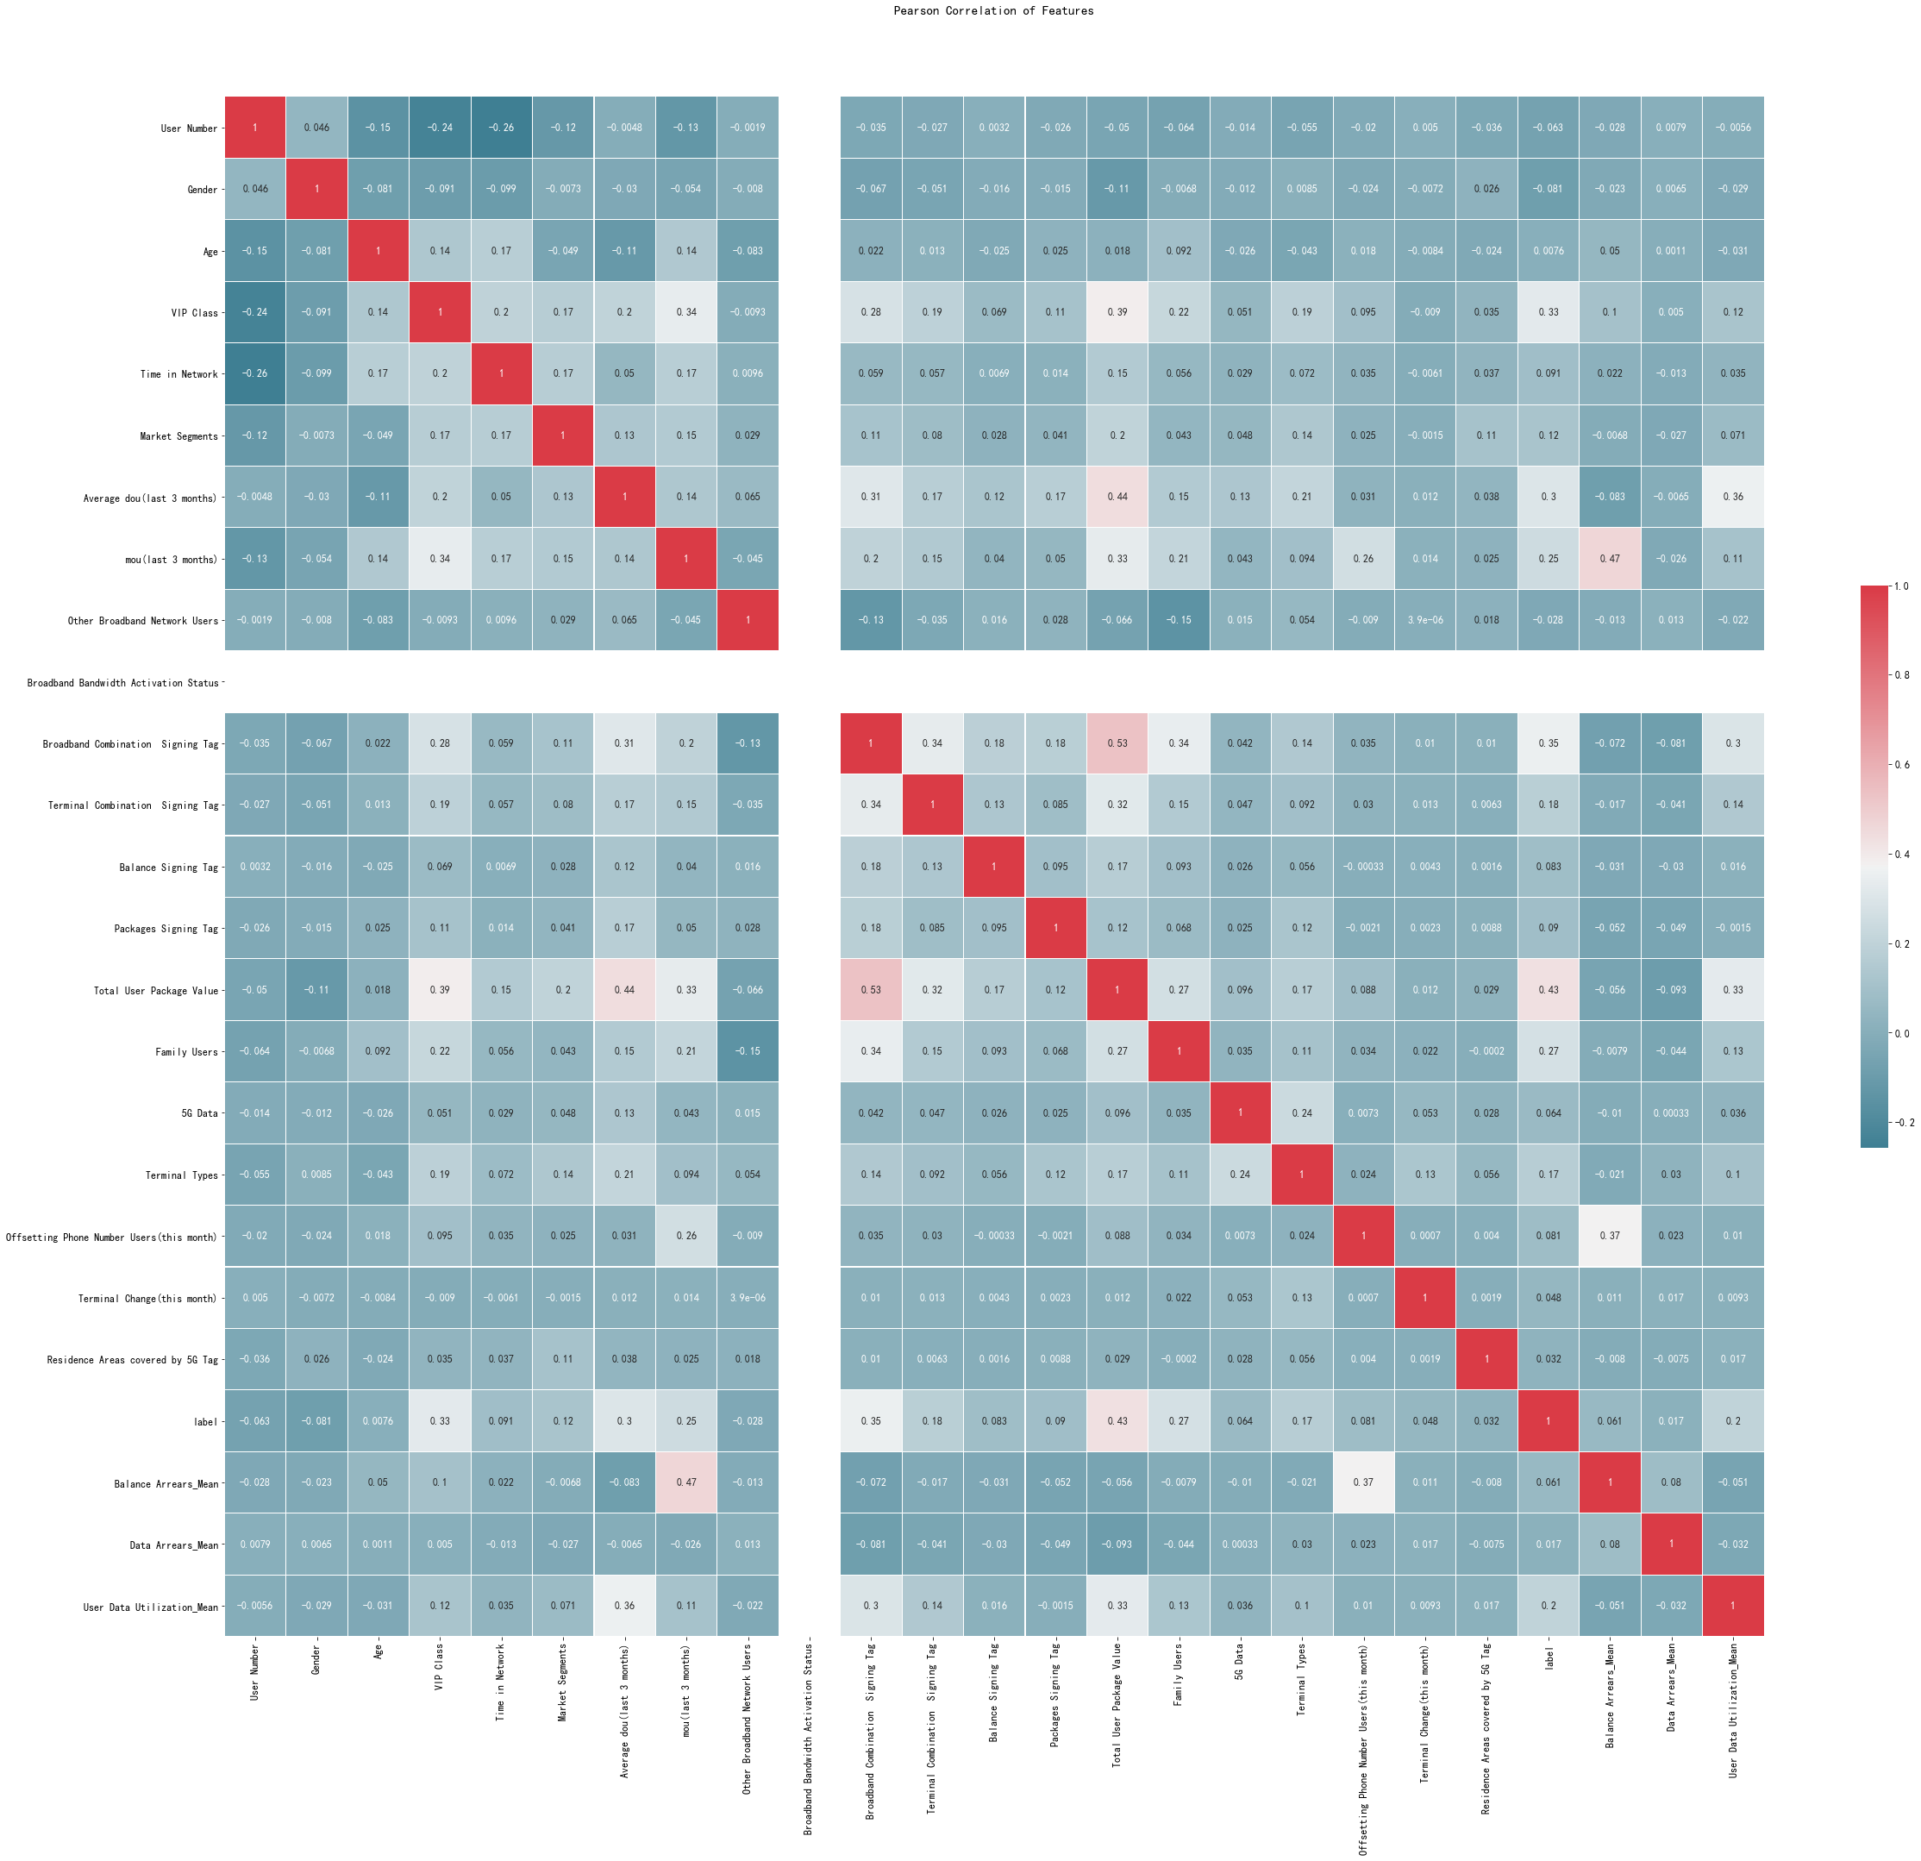
Before Reduction Processing
After Reduction Processing

Slide 10
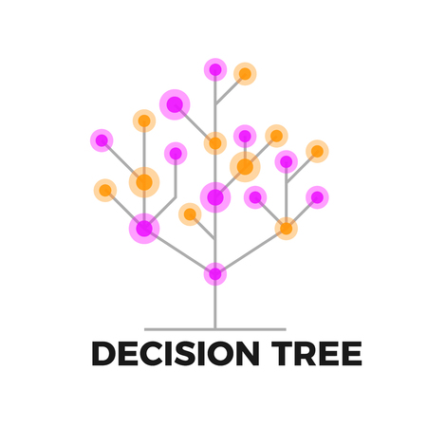


79% accuracy rate
Unqualified Recall (1.0 | 0.0)
AUC Parameter<0.5
82% accuracy rate
Recall(0.88|0.52)
Precision(0.88|0.52)
AUC Parameter=0.71
86% accuracy rate
Recall(0.88|0.55)
Precision(0.88|0.55)
AUC Parameter=0.78
😟
😀
😀

Slide 11
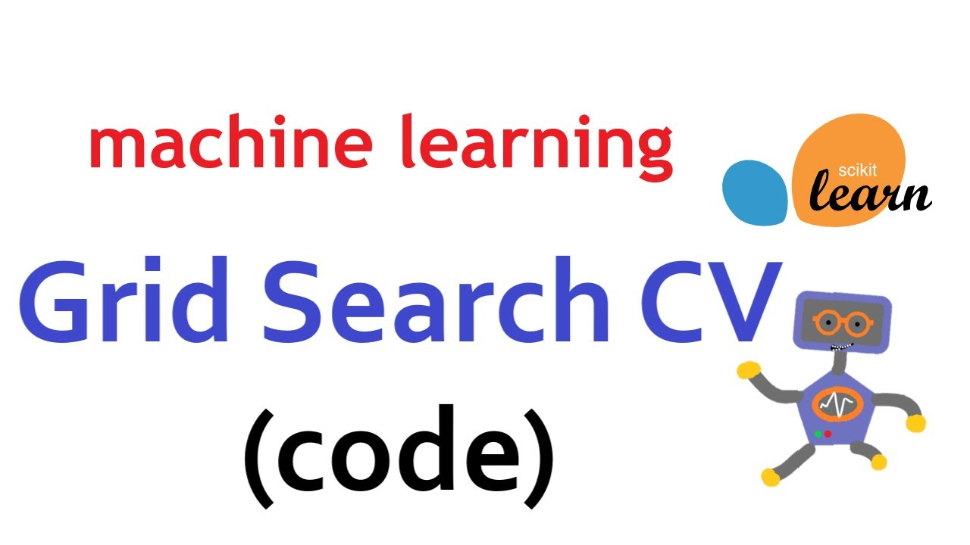
87% accuracy rate
Recall(0.93|0.63)
Precision(0.91|0.69)
AUC Parameter=0.78
max depth = 8
87% accuracy rate
Recall(0.94|0.57)
Precision(0.90|0.71)
AUC Parameter=0.76
max depth = 10
n estimator = 400

Slide 12

Predicted users of 5G in A
Predicted non-users of 5G in A
Customer Dataset A
(no 5G Label)
Customer Dataset B
(no 5G Label)
Predicted users of 5G in B
Final Model
Predicted non-users of 5G in B

Slide 13

Introduce contract machines
Bind users through contract purchases and extend the usage time.
Improve the accuracy of marketing
Diversify package products and provide personalized services. For example,
launch different traffic and voice combinations and terminal application-oriented traffic packages.
Lower the threshold of 5G usage
Set reasonable and favorable package prices according to different users’
consumption levels and needs. Carry out " ¥1 to open 5G package" and other promotional activities.
Combine packages with intelligent services
Optimize 5g packages for families and enterprises. Increase cooperation with terminal manufacturers. Provide services such as "smart family", "smart enterprise", "smart city", etc.
Improve 5G competitiveness
Conduct market analysis on competing products. Increase advertising and other promotional efforts to increase market share.
Marketing
Strategy

Slide 14

Context
Dataset EDA
Data Preprocessing
Model Selection
Model Evaluation
Parameter Tuning
Model Deployment
Business Analysis
Dataset with 5G Label
EDA
Logistic Regression
Dataset A (No Label)
Data Processing
Decision Tree
Dataset B (No Label)
Random Forest
Evaluation
Parameter Tuning
Final Model
Classification
Dataset A (with 5G Label)
Recommendation
on
5G Subscription Plan
Business Analysis
Dataset B (with 5G Label)
Strategy Design

Slide 15
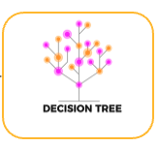

This project constructs a model to predict whether 4G users can switch to 5G users by using user information from mobile platforms.
Technical
Aspects
Conclusion
Introduce contract machines
Improve the accuracy of marketing
Lower the threshold of 5G usage
Combine packages with intelligent services
Improve 5G competitiveness
Marketing
Strategy

